Slide 1


Slide 2
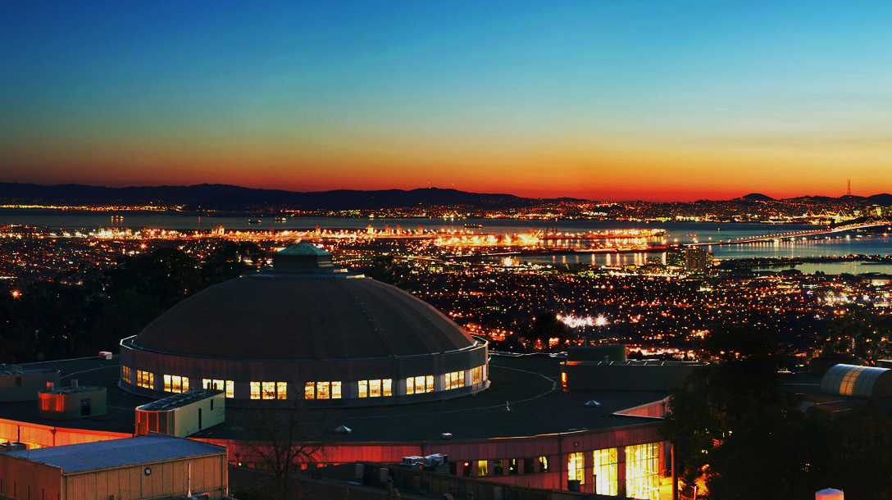




Slide 3

2015

Slide 4
who cares?

Slide 5
membranes
they let through things you want
and keep out the things you don’t

Slide 6


Slide 7
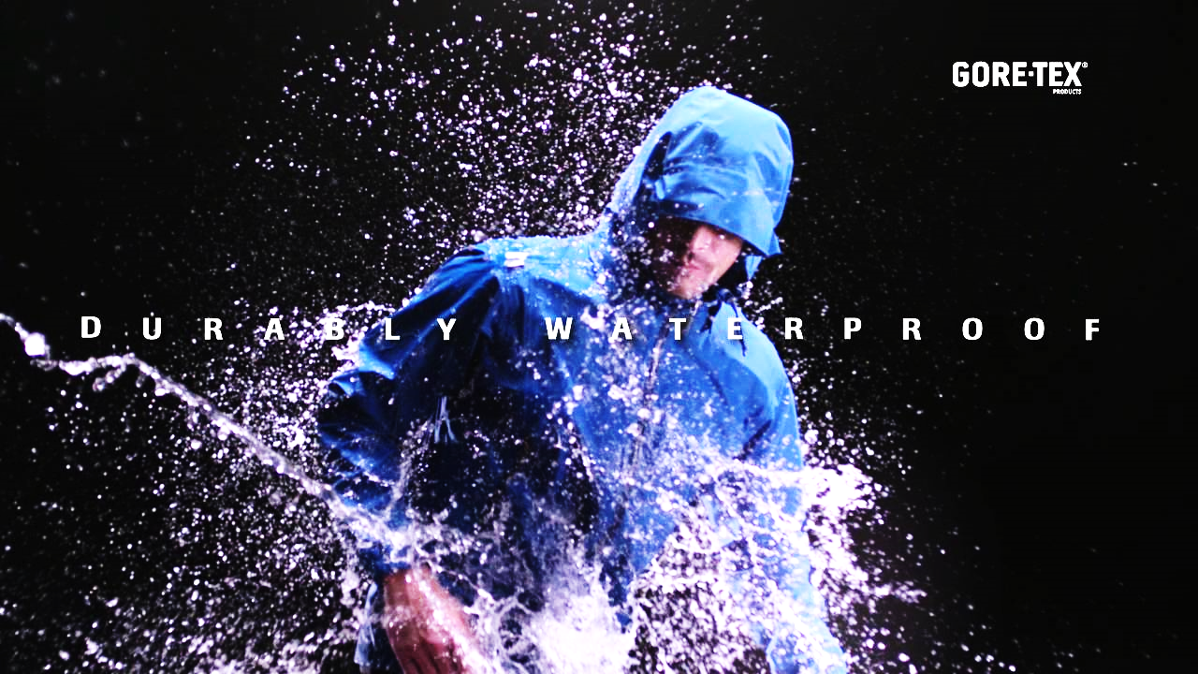


Slide 8
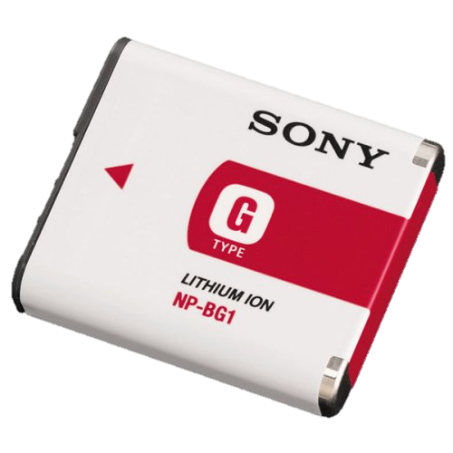
lithium ion battery membranes
membrane market
11 billion ft²
$1.5 billion

Slide 9
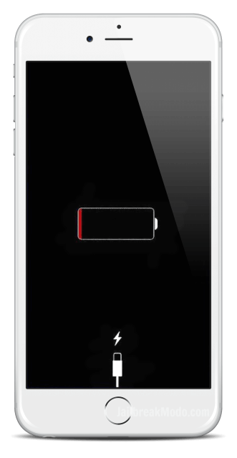

Slide 10
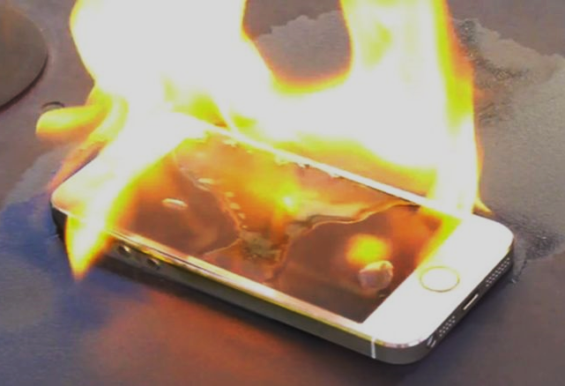

Slide 11

e–
e–
Li⁺
Li⁺
Li⁺
Li⁺
electrolyte
negative
membrane
positive

Slide 12
e–
e–
X
Li⁺
Li⁺
Li⁺
Li⁺
electrolyte
negative
membrane
positive

Slide 13
e–
e–
X
Li⁺
Li⁺
Li⁺
Li⁺
electrolyte
negative
membrane
positive

Slide 14
e–
e–
X
Li⁺
Li⁺
Li⁺
Li⁺
electrolyte
negative
positive

Slide 15
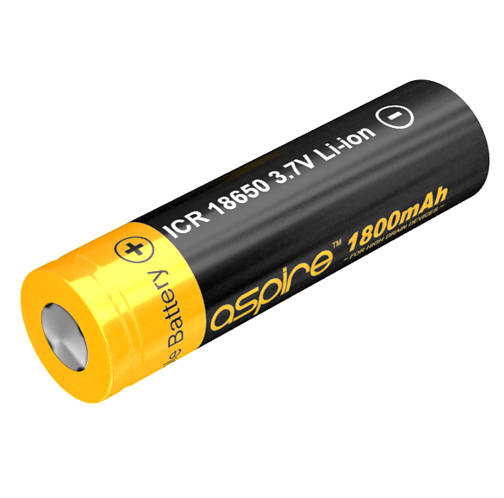
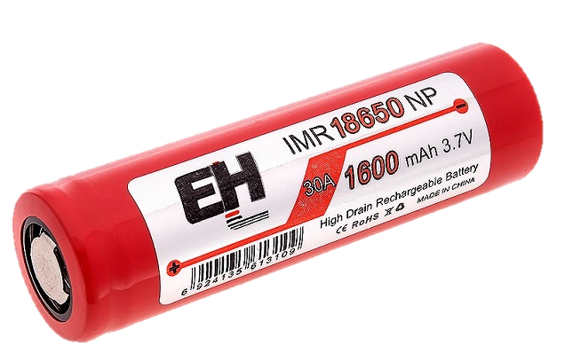
lithium-ion battery types
cobalt (LiCoO₂) |  | manganese (LiMn₂O₄)
1000 cycles |  | 500 cycles
dangerous |  | safe
$27.0/kg |  | $1.65/kg

Slide 16
1st product
commercial battery
membrane coating
for low-cost, long-life, and safe manganese-type lithium-ion batteries

Slide 17
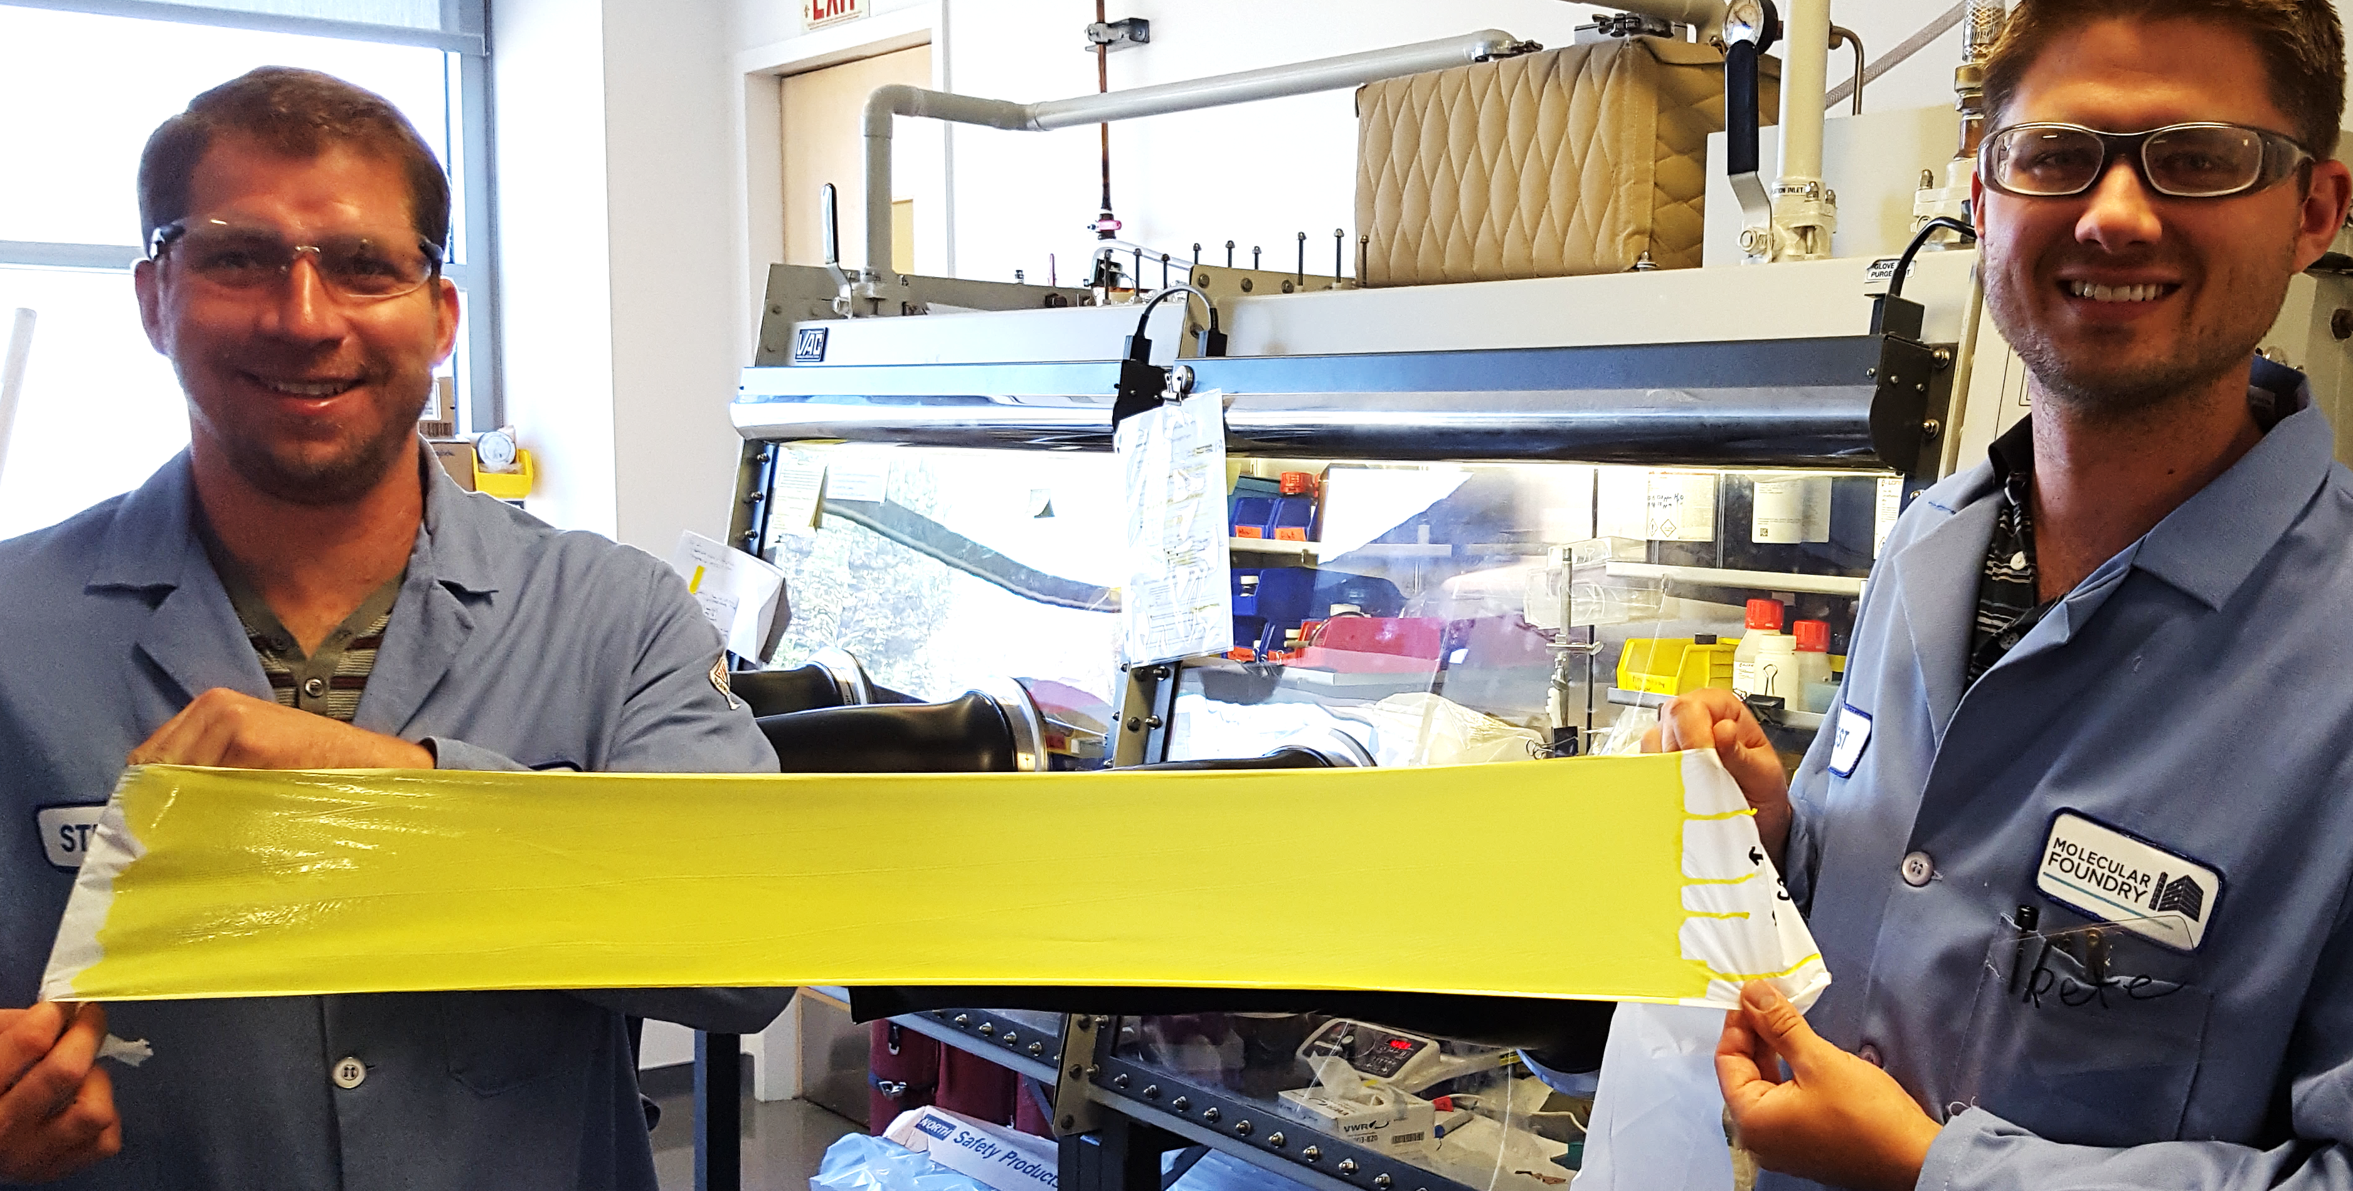
our solution drops into
existing battery manufacturing lines

Slide 18





$2.2 million
non-dilutive funding

Slide 19
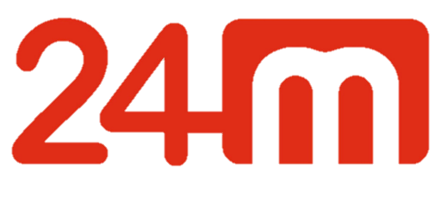
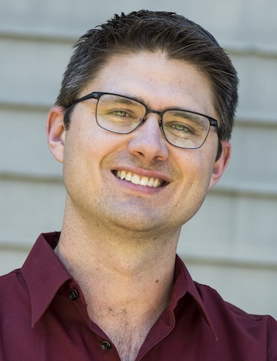


Our Team
Our Partners
Peter Frischmann
Brett Helms
Co-founder
Co-founder

Slide 20
SEPARATE THE GOOD FROM THE BAD
Peter Frischmann
(208) 406-9888
pete@sepiontechnologies.com

